Slide 1
Fish Market Dataset
Dominick Kolakowski, Mateen Olanrewaju

Slide 2
About the Dataset
Dataset has information relating to seven different species of fish
Dataset contains information from 159 different fish displayed along 7 columns
Dataset includes data such as:
Species
Weight
Vertical Length (Length1)
Diagonal Length (Length2)
Cross Length (Length3)
Height
Width
Width, Height, and all Length columns are measured in centimeters (cm)
Weight is measured in Grams (g)
Fish are grouped by species
Species: Bream, Smelt, Roach, Whitefish, Parkki, Perch, Pike
Dataset was created by Aung Pyae and was published to Kaggle: https://www.kaggle.com/datasets/aungpyaeap/fish-market

Slide 3
Goals for Project
Determine the accuracy of these dataset results using two different models
Determine which of the seven breeds has the highest numbers overall across all categories

Slide 4
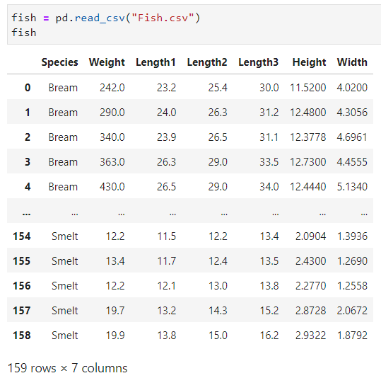
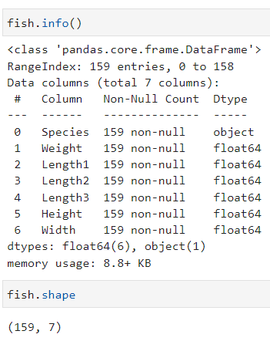
Dataset Table

Slide 5
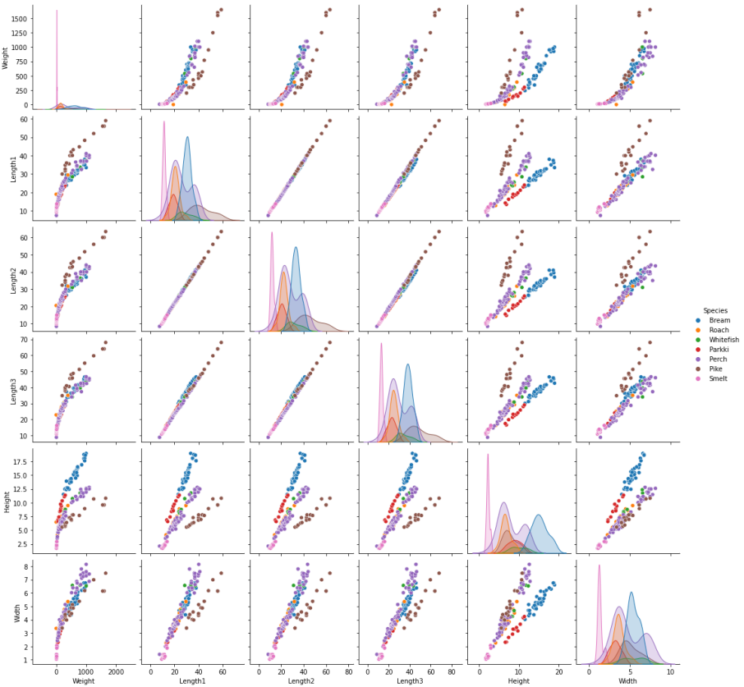

KNN (K-Nearest Neighbors)

Slide 6
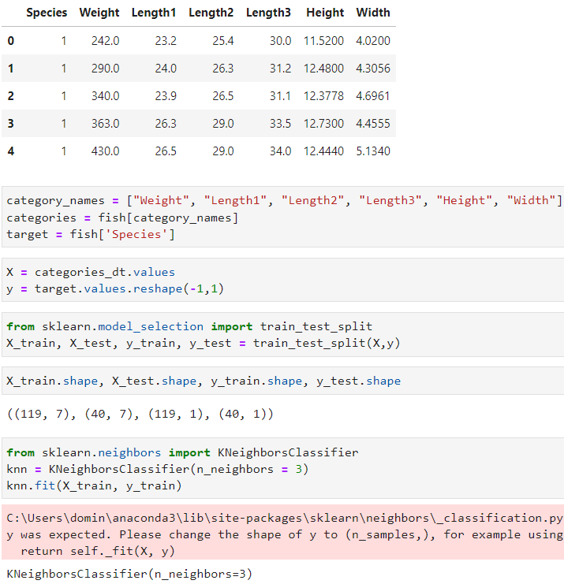
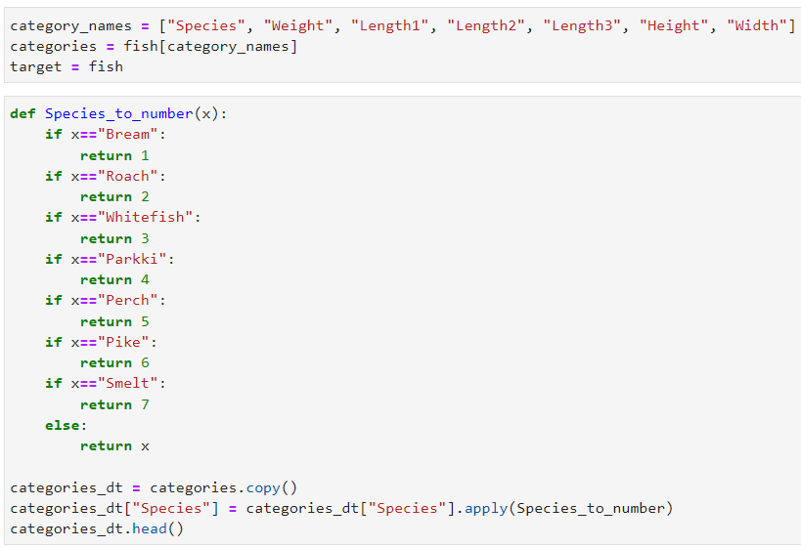

KNN (Continued)

Slide 7
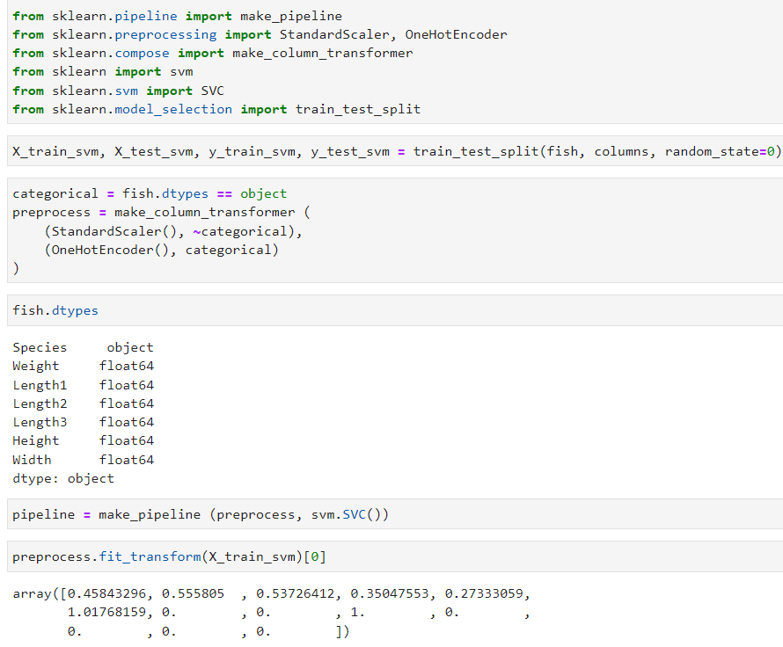
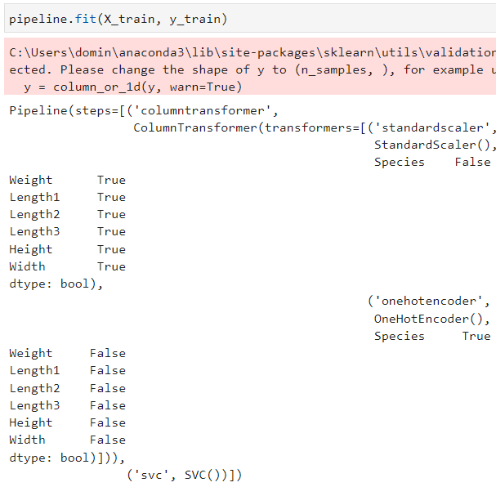

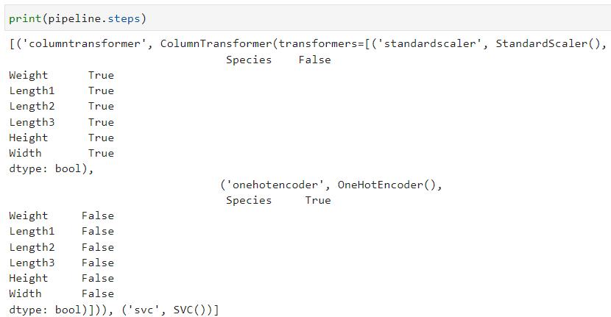
SVM

Slide 8
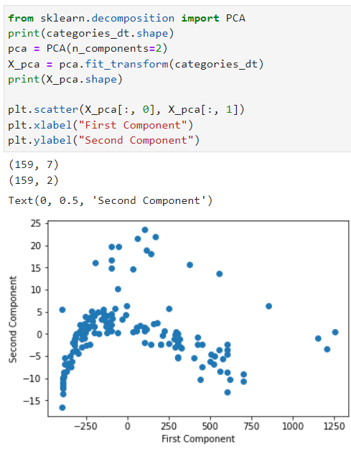
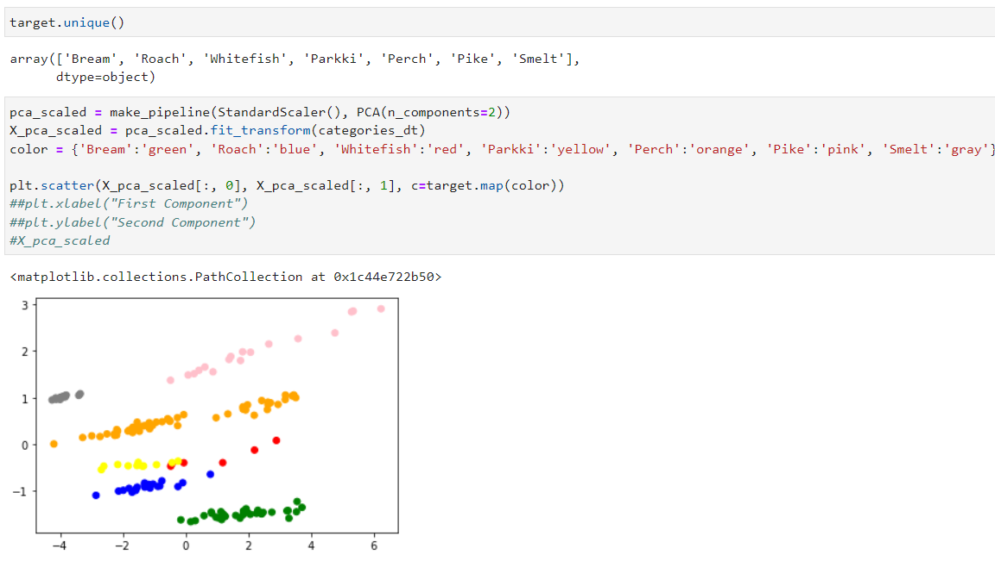
SVM (Continued)

Slide 9
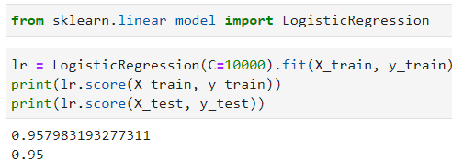
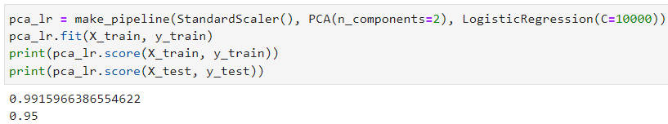
SVM (Continued)

Slide 10
Conclusion
While the KNN states that the table is only about half correct, the SVM states that it is 100% accurate.
Based off of the pairplot tables, it seems that the Pike breed has the highest numbers overall.

Slide 11
RESOURCES
Fish market | Kaggle

Slide 12
Thank You!

